Slide 1

IoT-Enabled Intelligent Home Assistant with Power Management Features
Sai Ram Reddy Ganta–
MSc Electronic and Computer Technology (IoT) DUBLIN CITY UNIVERSITY, IRELAND | August 2025
​

Slide 2

INTRODUCTION
• IoT revolutionizing smart homes.
• Need for an energy-efficient, low-cost automation.
• Gap: Most works highlights convenience ; fewer focus on power management in DC-powered systems.

Slide 3

Problem STATEMENT:
• Existing smart home systems rely on high power / AC supply.
• Lack of lightweight, energy-optimized IoT frameworks.
• Limited integration of fan speed control + occupancy-based automation in low-voltage DC systems.

Slide 4
Objectives
• Design a low-cost IoT assistant with ESP32 + Arduino Uno.
• Integrate DHT11 + PIR for environment and occupancy monitoring.
• Implement the MQTT protocol for lightweight communication.
• Provide real-time monitoring via LCD.
• Achieve energy optimization with battery operation + ESP32.

Slide 5
Literature Review (Related Work)
• Ref 1–4: Focus on voice control & basic automation.
• Ref 5–8: Emphasize MQTT, modular design, low-cost DC systems.
• Ref 9–10: Extend toward intelligent energy management, including predictive optimization.
• Gap: Power management + DC low-voltage scalability not addressed extensively.

Slide 6
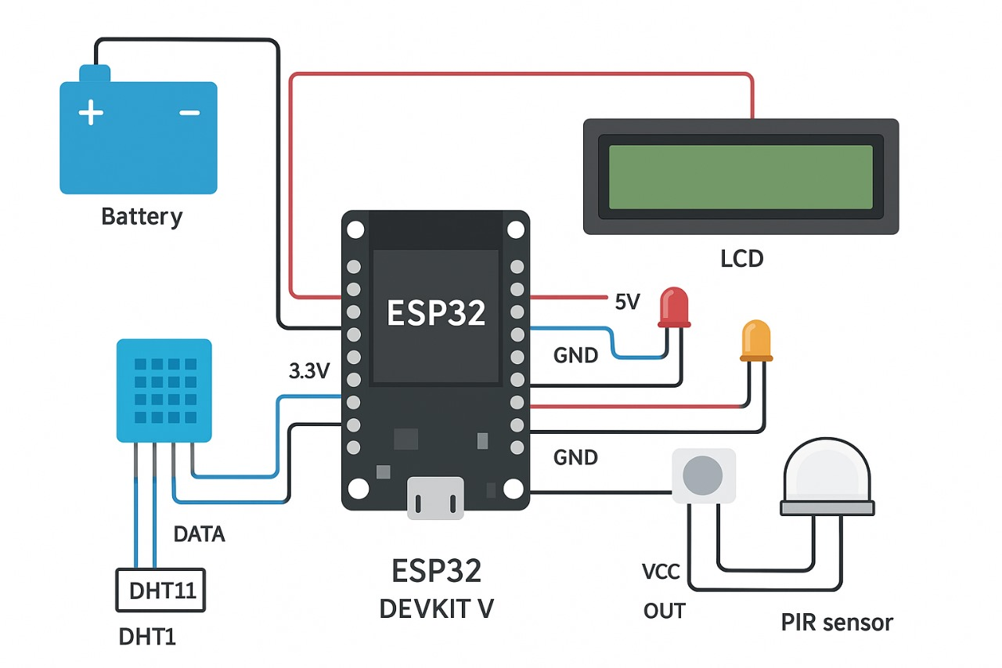
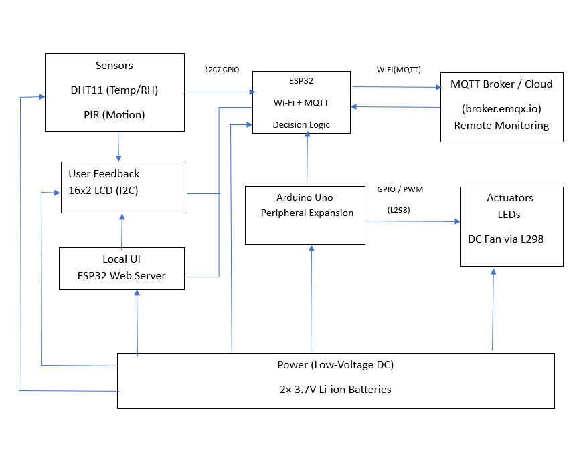
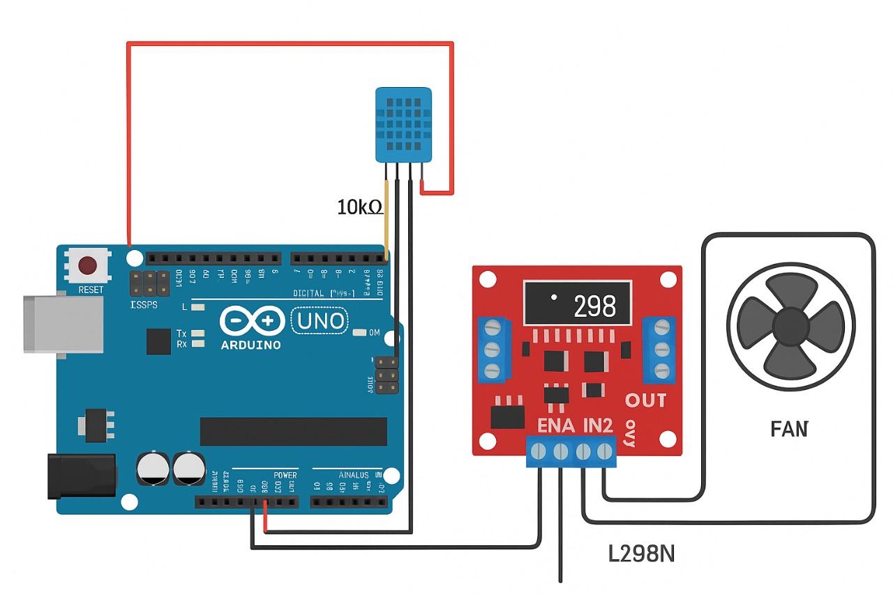
System Architecture Overview
Fig. b. Circuit diagram of ESP32 with DHT11, PIR, LCD, LEDs, and battery supply
Fig. a. System architecture of the IoT-Enabled Intelligent Home Assistant.
Fig. c. Circuit diagram of Arduino Uno with L298 motor driver controlling DC fan

Slide 7
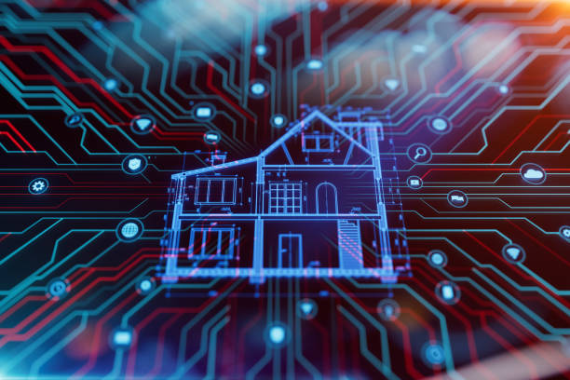
HARDWARE COMPONENTS
• ESP32 as central controller.
• Arduino Uno for modular expansion.
• DHT11 & PIR for sensing.
• 16x2 LCD for real-time feedback.
• LEDs + Fan for appliance control.
• 3.7 volts Li-ion batteries as power source.
• MQTT over Wi-Fi for communication.

Slide 8

SOFTWARE REQUIREMENTS
• Arduino IDE + C/C++ programming
• MQTT protocol (publish–subscribe)
• Wi-Fi for real-time connectivity
• Algorithms for fan speed, occupancy control, and power-saving
• LCD display driver libraries
• Web dashboard for remote monitoring

Slide 9
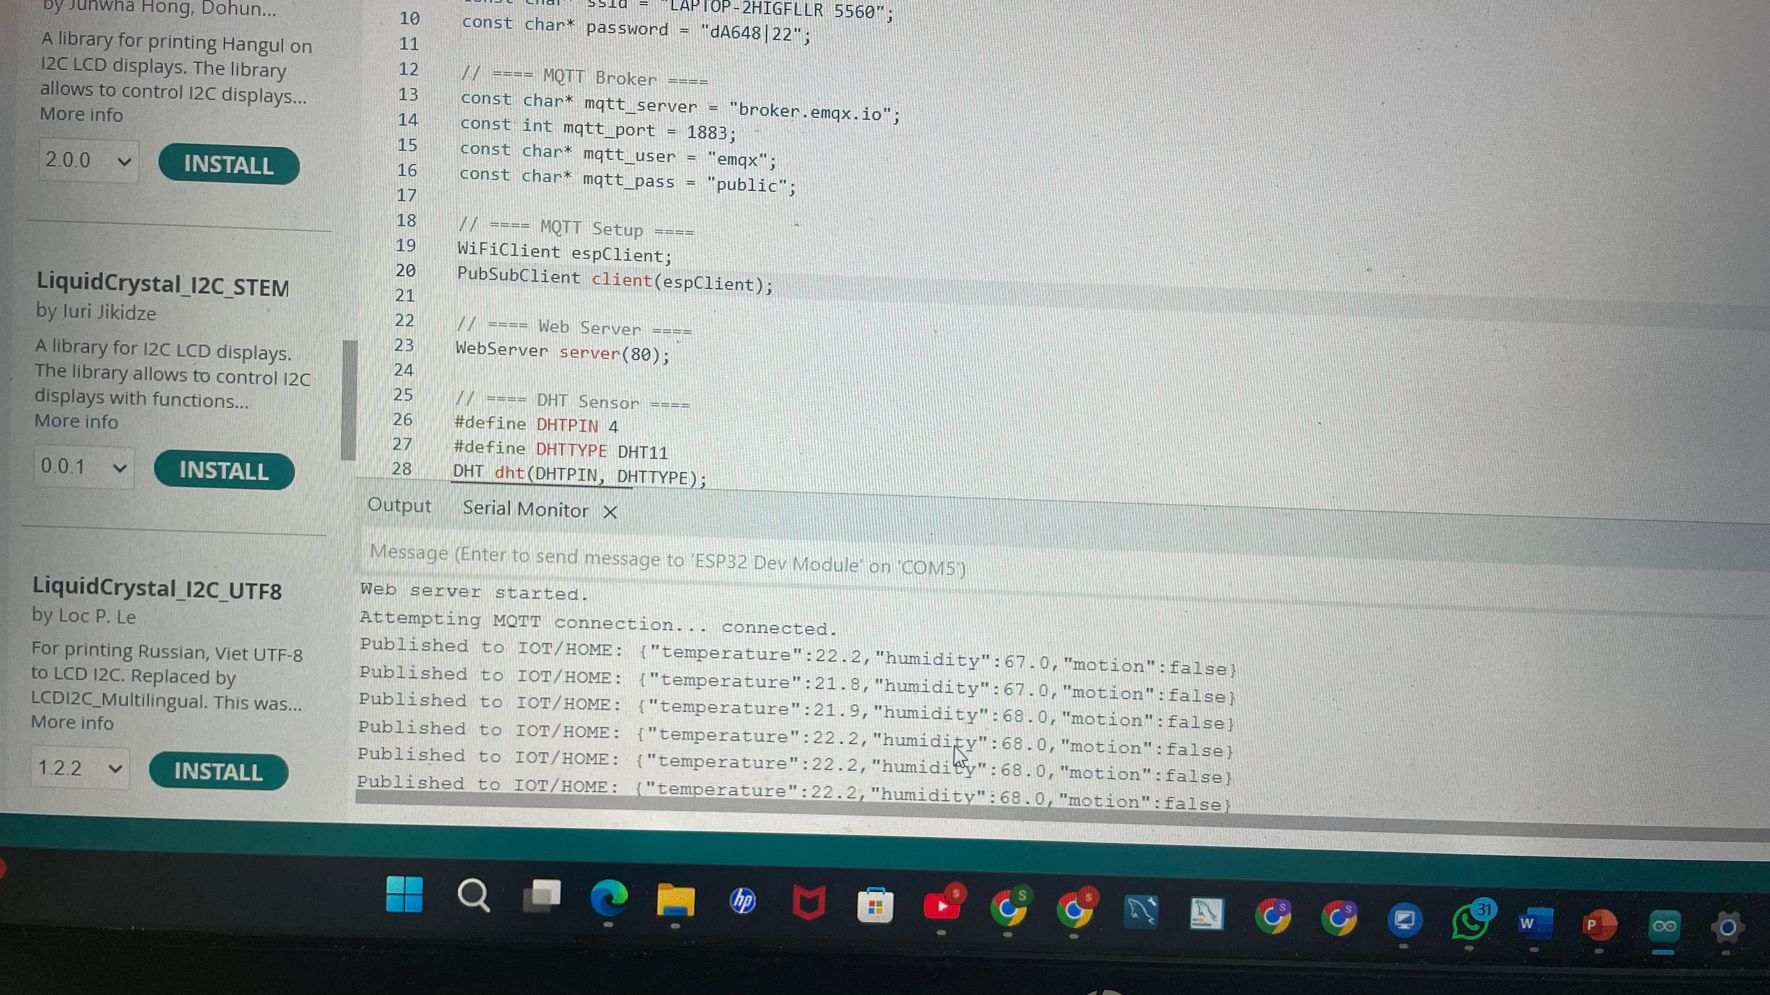
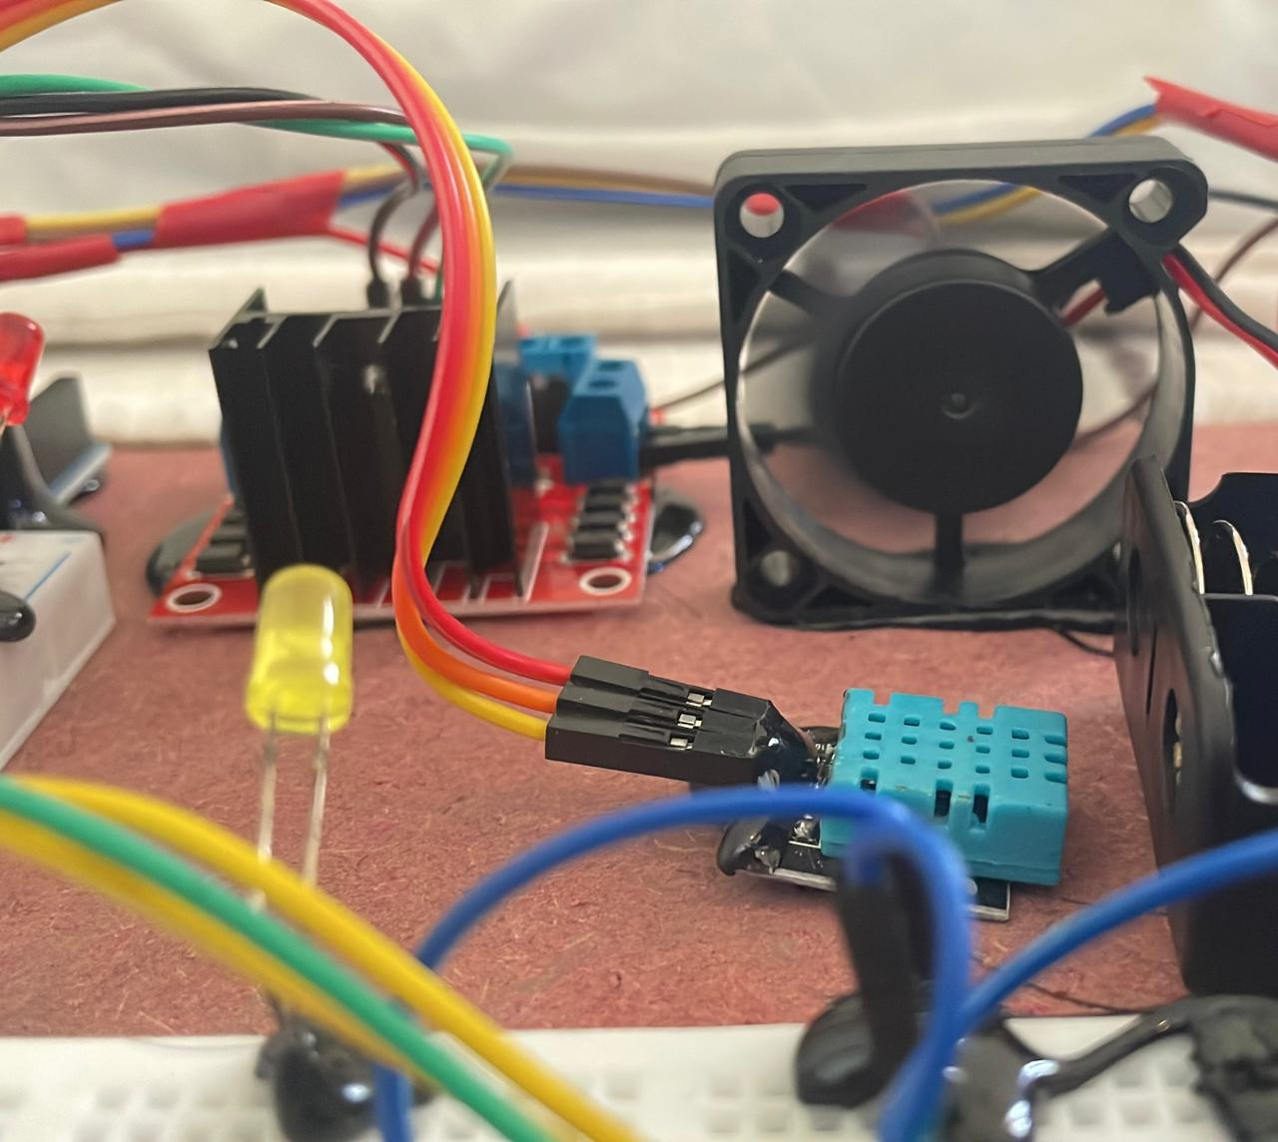
results and ANALYSIS:
• Fan speed adjusts automatically based on temperature & humidity
• PIR triggers appliances only when occupancy detected
• LCD shows live sensor data
• Energy-efficient through ESP32 low-power modes
Fig. 1: Serial Monitor showing MQTT data being published.
Fig. 2: Fan connected through L298 driver with battery supply.

Slide 10
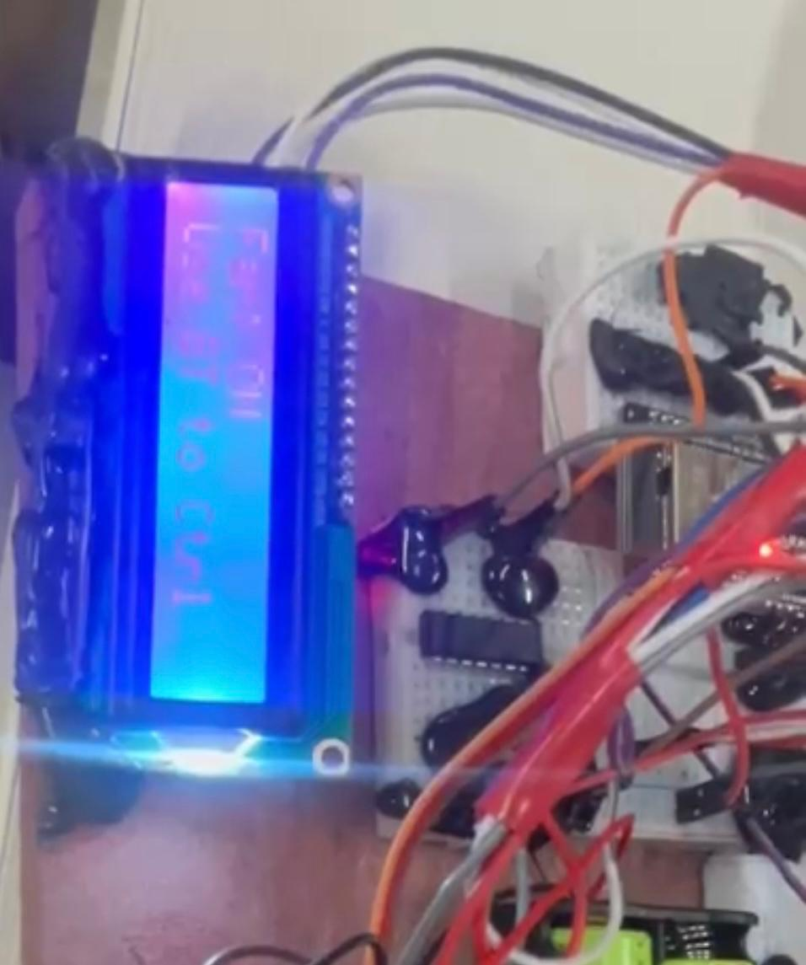
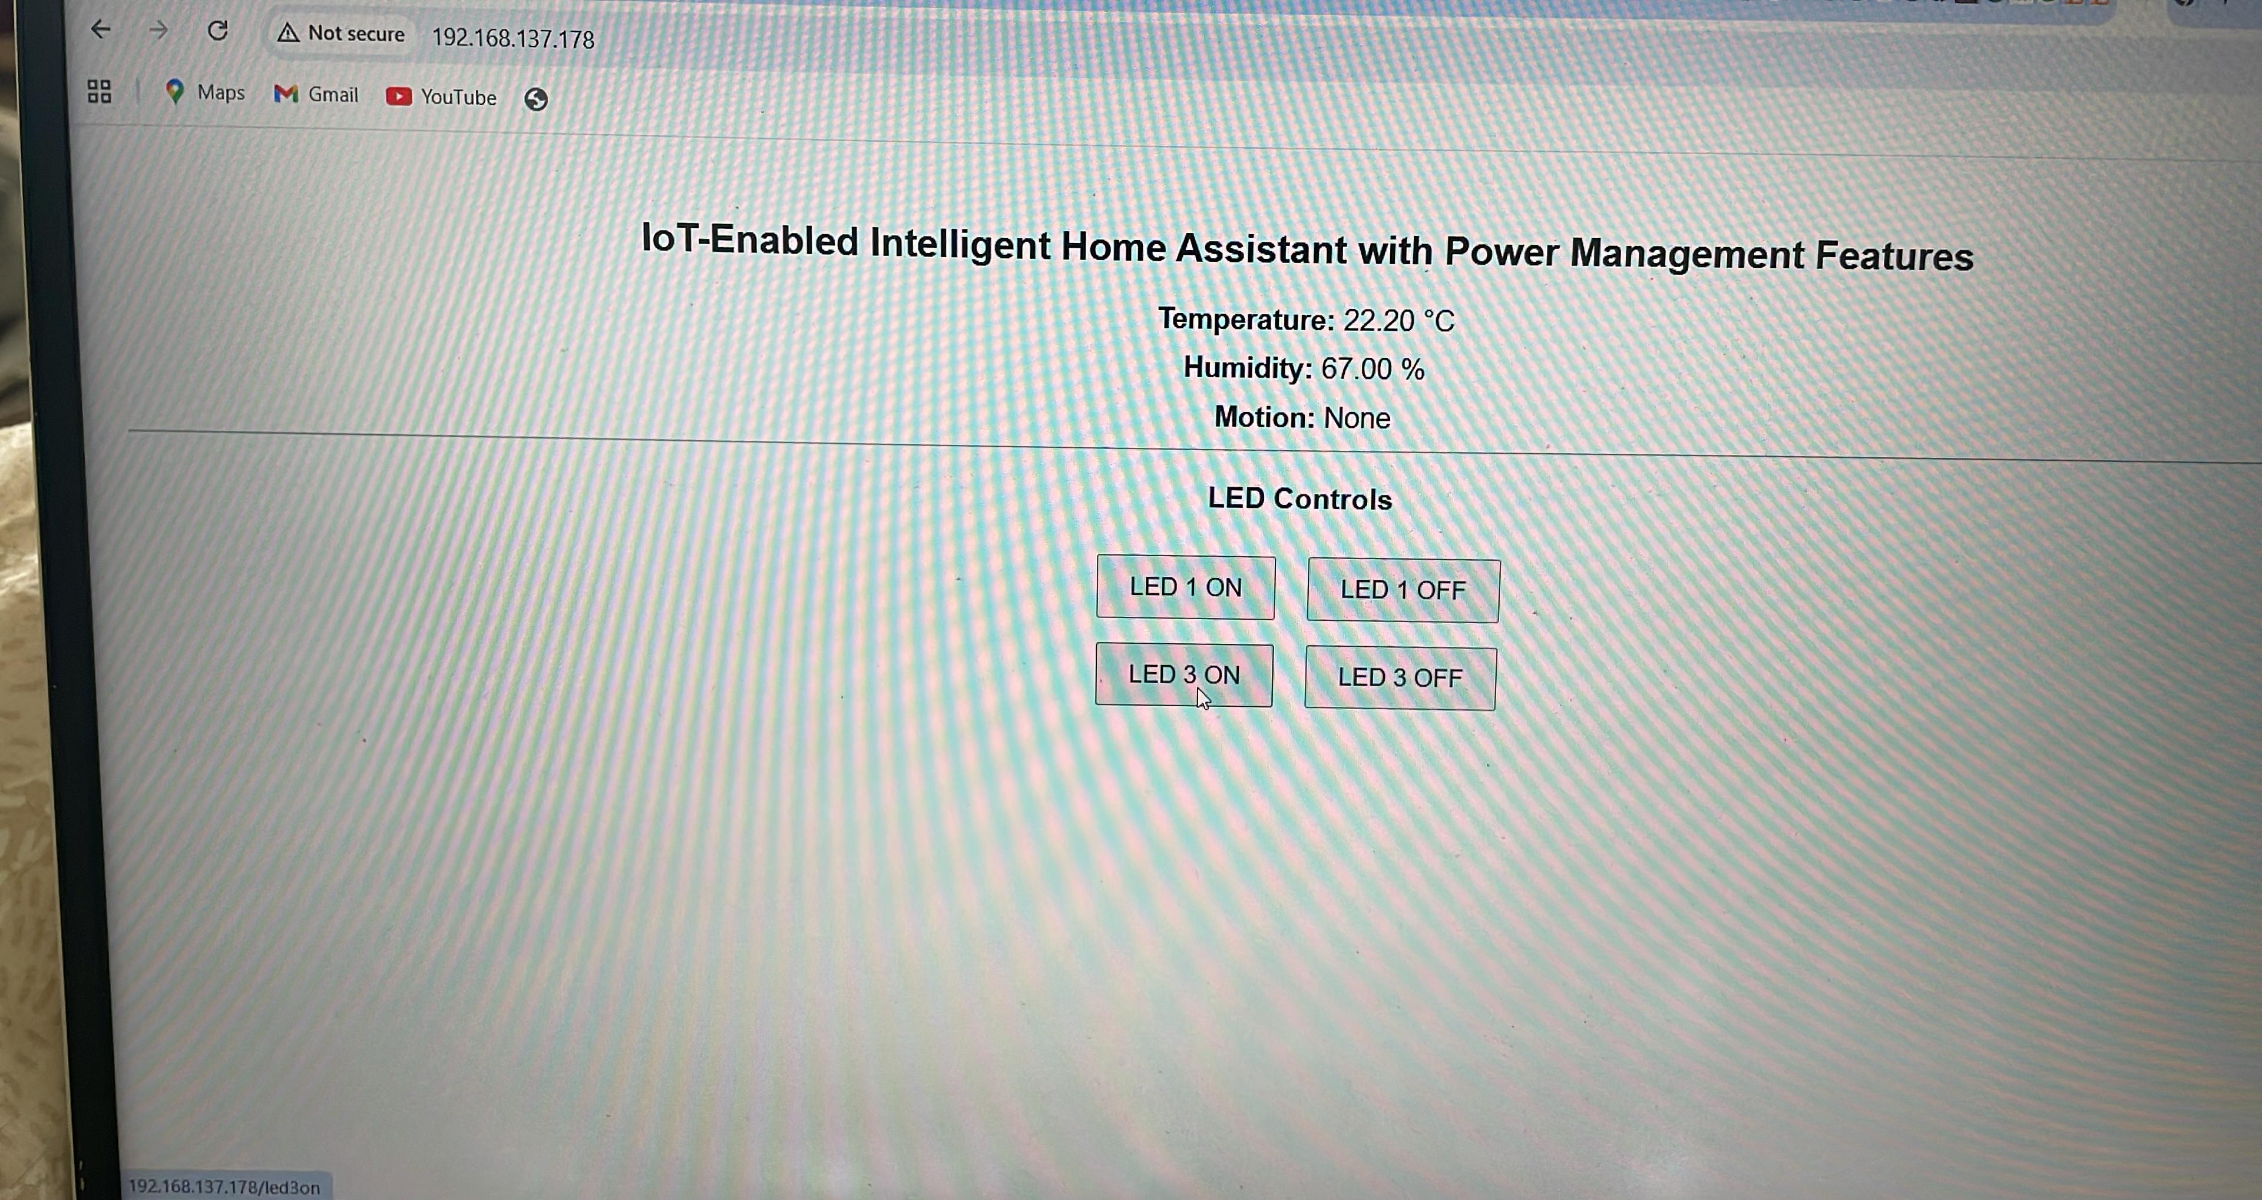
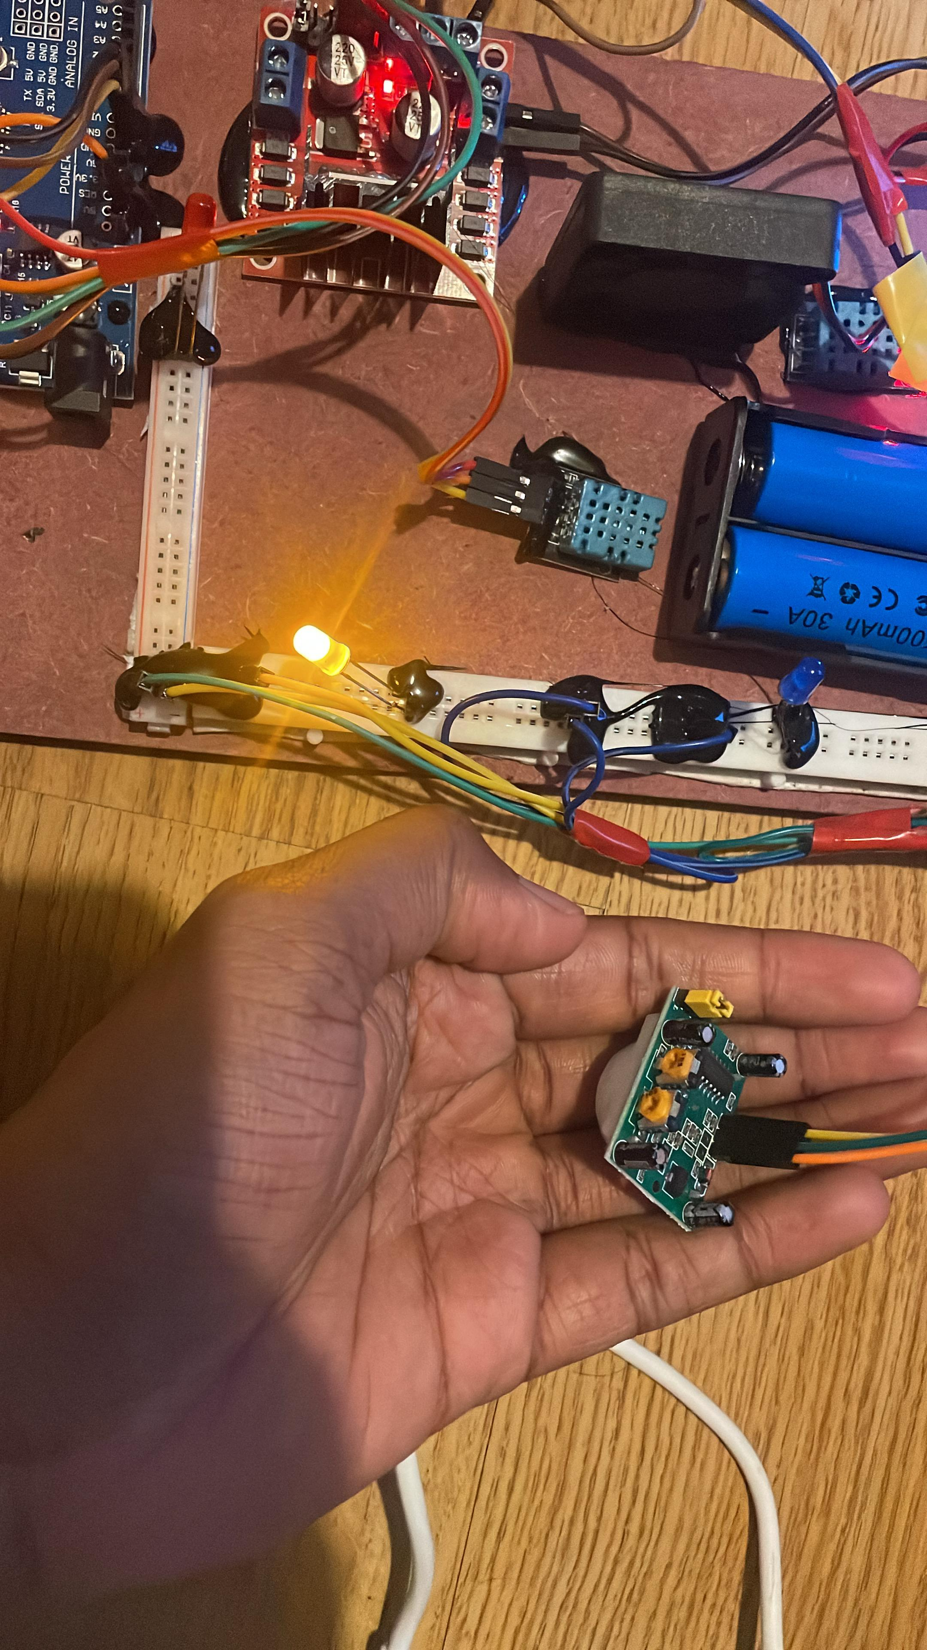
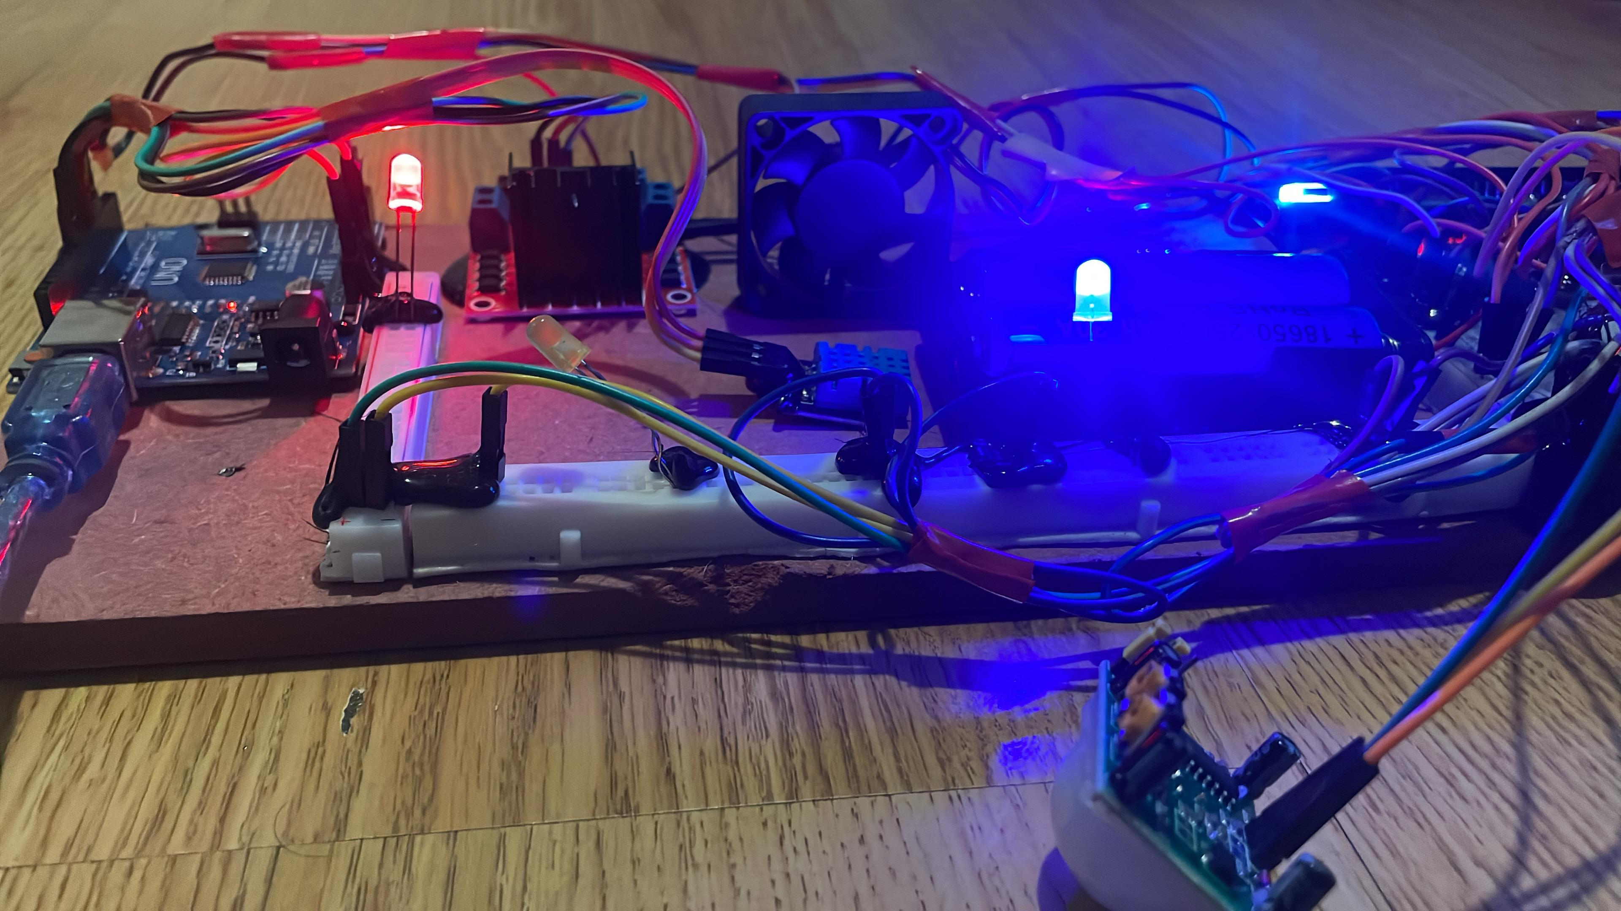
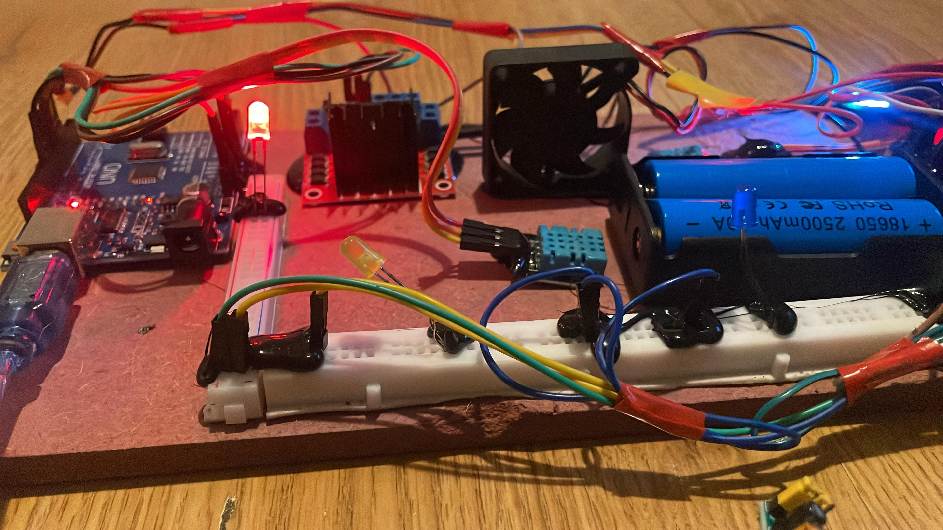
Fig. 5: LCD display showing live data and fan state.
Fig. 6: Picture of Web Interface (LED Control + Sensor Display
Fig. 3: PIR sensor detection test (LED ON during motion).
Fig. 7: LED modules operating together under control logic.
Fig. 8: LED 3 module operating manually under control logic through web interface.

Slide 11
ADVANTAGES:
• Low-cost and scalable design.
• Operates on low-voltage DC, safe and portable
• Real-time monitoring with MQTT + LCD.
• Modular – easy to expand with more sensors.
LIMITATIONS:
• Dependent on stable Wi-Fi connection.
• Limited processing power for advanced analytics.
• Battery life depends on load and duty cycling.

Slide 12
REAL WORLD APPLICATIONS AND SCALABILITY
• Smart homes in urban & rural settings.
• Energy-efficient hostel rooms/apartments.
• Scalable to smart buildings, offices, classrooms.
• Expandable with sensors (gas, light, water level, etc.).

Slide 13

Future work:
• Cloud integration for data logging (Firebase/Thingspeak).
• Voice control with Alexa/Google Assistant
• L298 can be replaced with efficient MOSFET motor drivers for an extended battery.
• AI/ML for predictive automation.

Slide 14
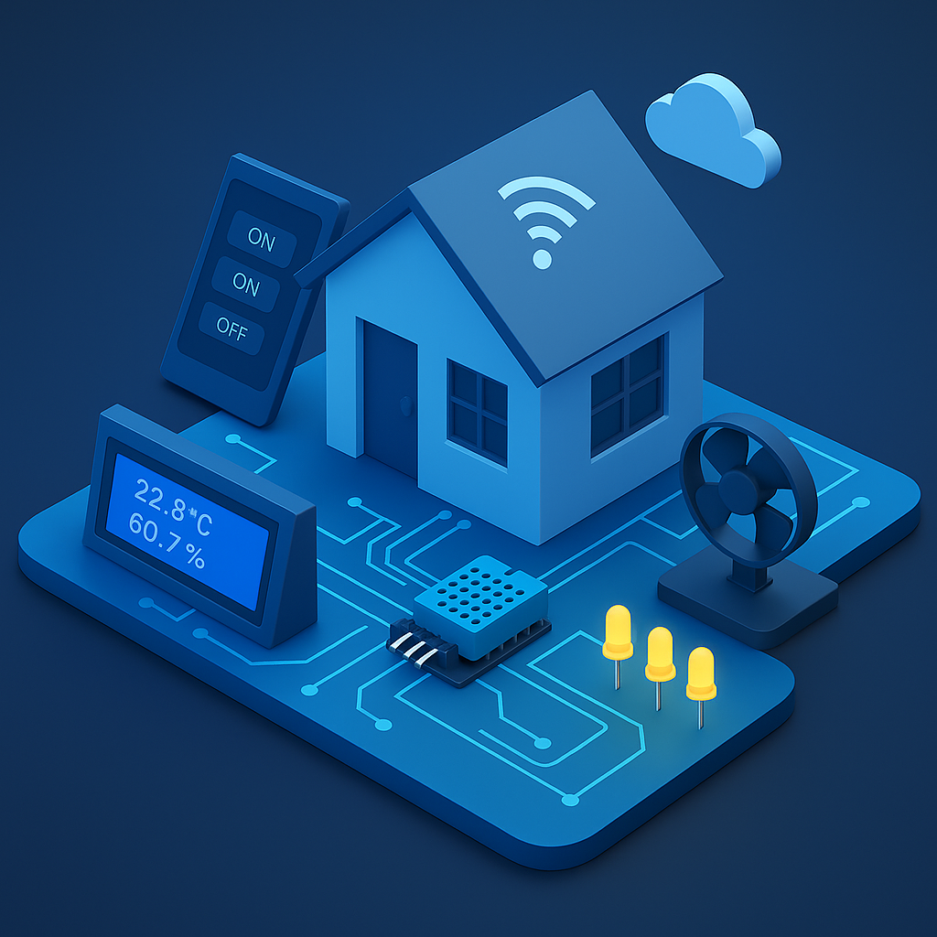
CONCLUSION:
• Demonstrates low-cost, scalable IoT assistant.
• Prioritizes energy efficiency in DC-powered systems.
• Reliable real-time monitoring & automation using MQTT.

Slide 15


